Slide 1

THE ROLLING SCOPES SCHOOL
Infrastructure as Code & Configuration Management
Emil Garipov

Slide 2

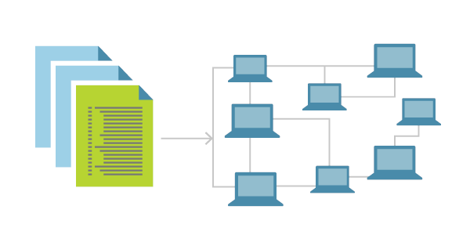
Introduction to Infrastructure as Code
Write a code to manage infrastructure
IaC defenition
Infrastructure as Code (IaC) is a technology that allows you to manage and provision infrastructure resources using code.
This means that instead of manually configuring servers, networks, and other infrastructure components, you can use code to automate the process.
This code can be version-controlled, tested, and deployed just like any other software code.

Slide 3

Key Concepts of Infrastructure as Code
Declarative Configuration
Desired State Configuration
Idempotency
Immutability
Configuration Management

Slide 4

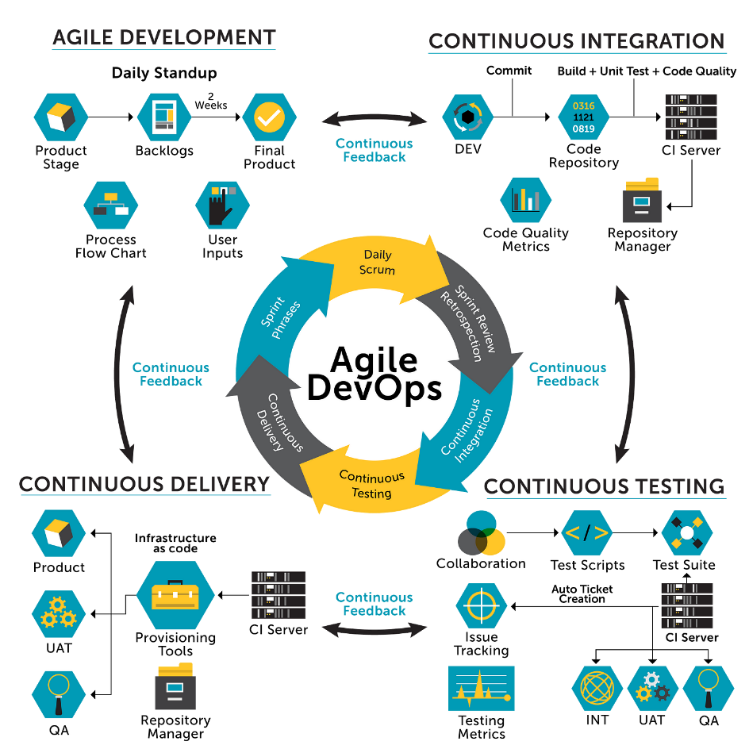
Benefits of Infrastructure as Code
Consistency
Reproducibility
Scalability
Version control
Collaboration

Slide 5

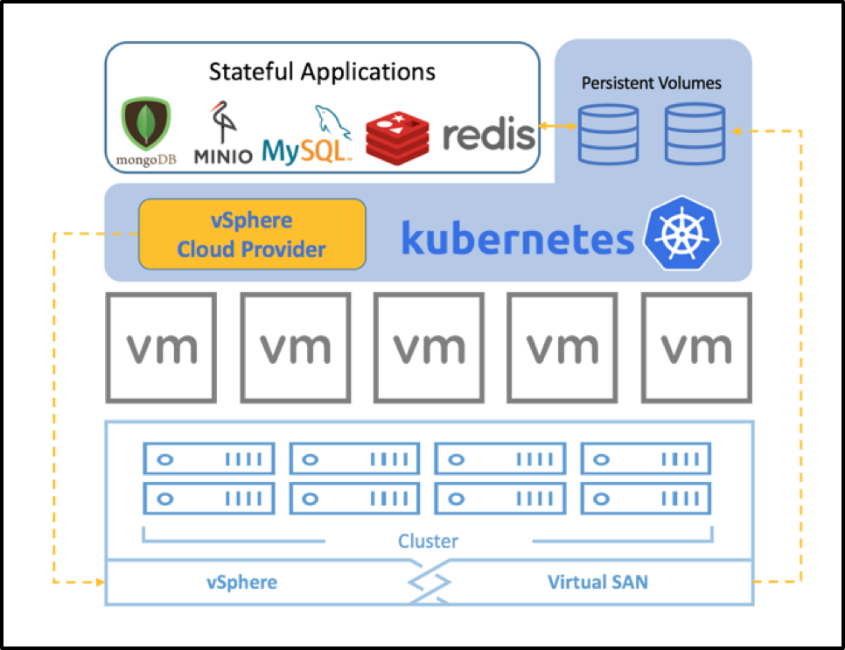
What can infrastructure be used for as code?
Infrastructure components
Virtual machines
Containers
Network infrastructure
Databases
Security

Slide 6

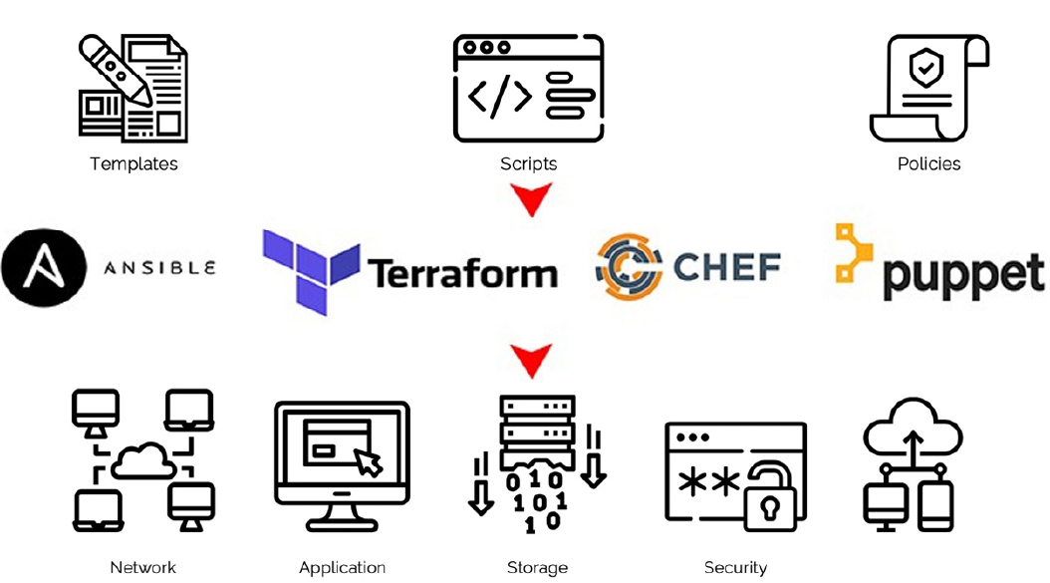
Some popular Infrastructure as Code Tools
Terraform
Ansible
Chef
Puppet
Saltstack
AWS CloudFormation

Slide 7

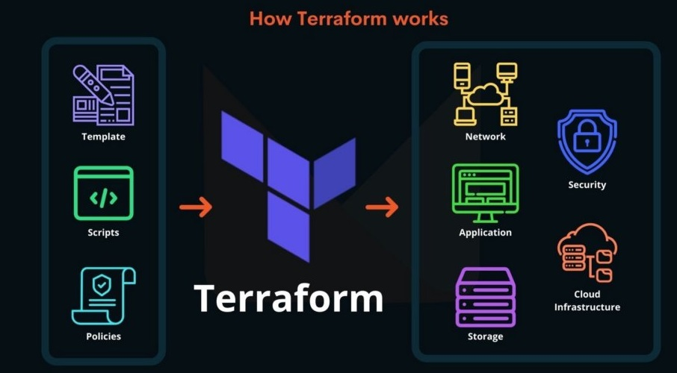
What are the benefits of using Terraform?
Infrastructure as Code
Multi-Cloud Support
Declarative Syntax
Modular Architecture
Plan and Apply
State Management

Slide 8

Demo
Task
Create EC2 Instance t2.micro:
Ubuntu
EC2 Ubuntu there must be incoming access: to the TCP/22 and any outgoing access.

Slide 9

Best practices for implementing Infrastructure as Code
Reusable code
Version control
Using modules
Infrastructure Testing
Continuous Integration and Deployment
Store state file remotely

Slide 10

Useful Resources
What is Infrastructure as Code? (Tutorial) - https://www.freecodecamp.org/news/what-is-infrastructure-as-code/
AWS Infrastructure as Code Workshops - https://www.workshops.aws/categories/Infrastructure%20as%20Code
Azure Infrastructure as Code Workshop - https://azuredevcollege.com/iac-basics-workshop/#azure-resource-manager
Getting Started with Terraform for Google Cloud - https://www.cloudskillsboost.google/course_templates/443

Slide 11


Slide 12

Thank you

